Slide 1
Weather Classification and Weather Style Migration
Chenhao Zhu, Wu Yifei, Hua Zhong

Slide 2

Weather Classification
Data Sourse : kaggle competition.
Sunrise, Shine, Rainy, Foggy, Cloudy

Slide 3
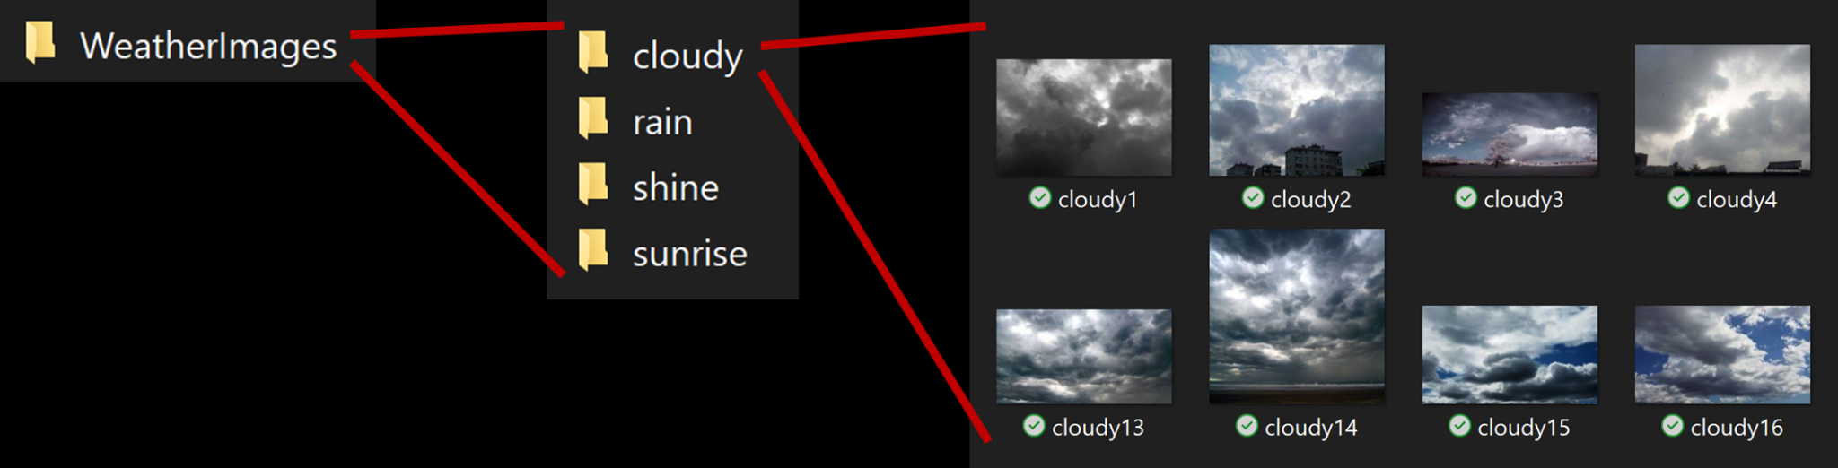

Slide 4
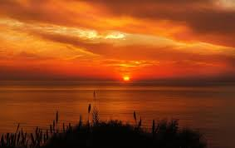
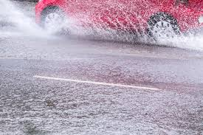
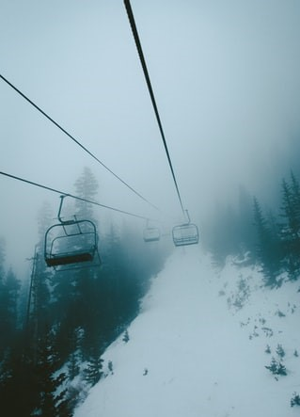
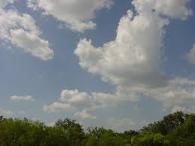

Foggy
Sunrise
Rainy
Shine
Cloudy

Slide 5
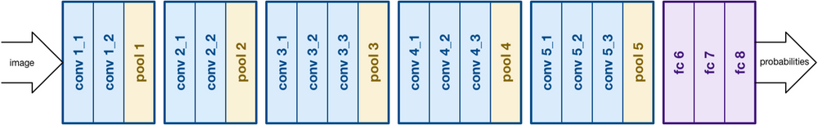
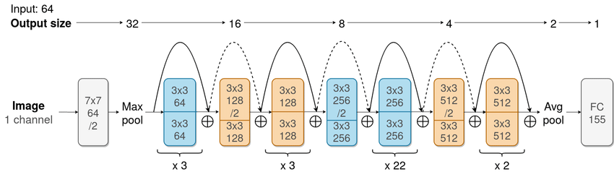
Architecture
Building on the work of AlexNet, VGG focuses on another crucial aspect of Convolutional Neural Networks (CNNs), depth.All the convolutional layers consists of 3x3 filters.
VGG-16
Resnet let stacked layers layers fit a residual mapping. It is realized by feedforward neural networks with “shortcut connections”. No degradation problem is observed on Resnet-101 and thus enjoy significant accuracy gains from considerably increased depth.
Resnet-101

Slide 6
Three Models
Simple CNN — Fast in training but low validation accuracy (below 70% correct in 30 epoches)
6 Layers, combined with 3 Convoluation layers and 3 fully connected layers
VGG — Slow in training but high validation accuracy (reached 82.6% in 20 epoches)
13 layers + 3 fully connected layers
ResNet — Slow in training but high validation accuracy (above 94% in 8 epoches)
Pretrained Model, shortcut connections, 101 layers (more3-layerblocks)

Slide 7
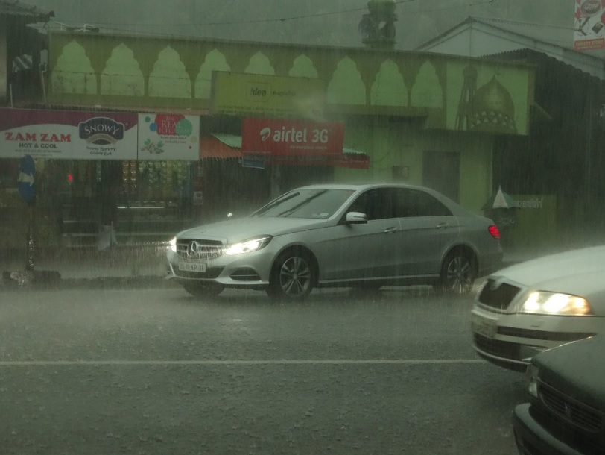
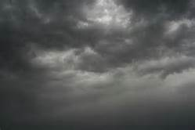
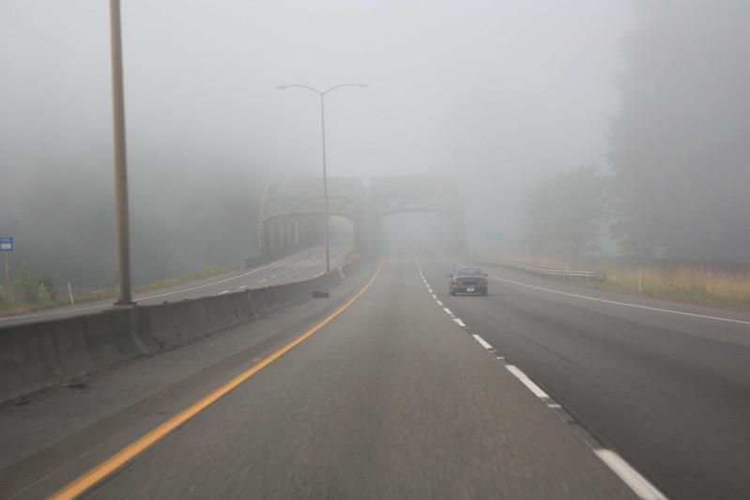


Test Data From Kaggle:
True: Rainy
VGG16: Class 2 (Rain)
Resnet: Class2 (Rain)
True: Cloudy
VGG16: Class 0 (Cloudy)
Resnet: Class 0 (Cloudy)
True: Foggy
VGG16: Class 1 (Foggy)
Resnet: Class 1 (Foggy)
True: Sunshine
VGG16: Class 4 (Sunrise)
Resnet: Class 3 (Shine)
True: Sunrise
VGG16: Class4 (Sunrise)
Predict: Class 4 (Sunrise)

Slide 8
Testing VGG16 and Resnet on the Kaggle test dataset
Accuracy Score Overall:
VGG16 : 80 %
Resnet : 100 %

Slide 9
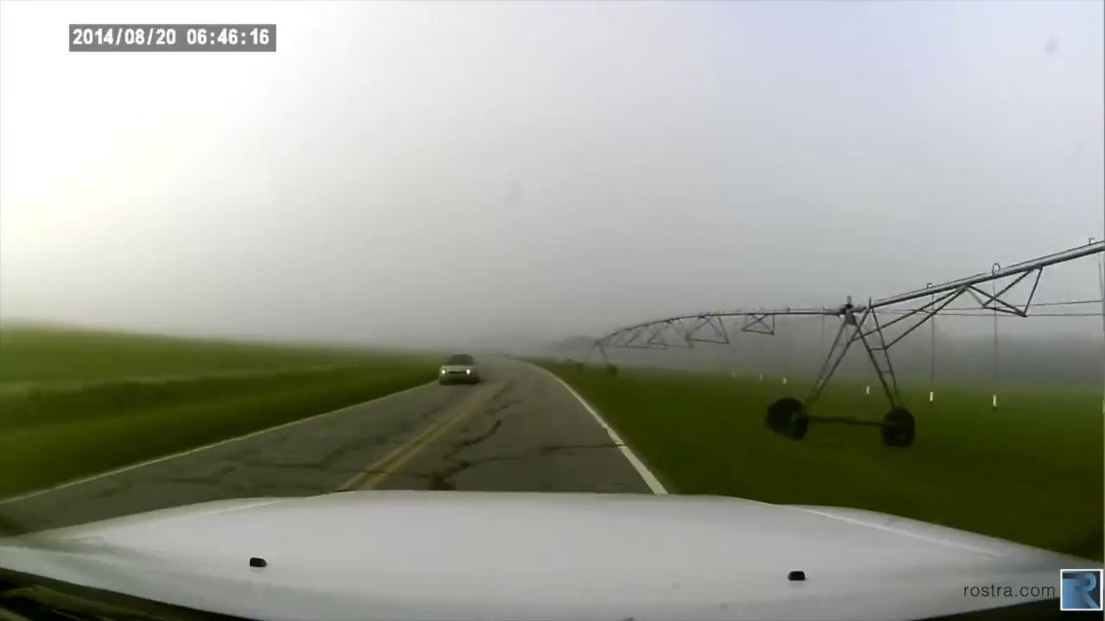
Driving Video Example:

Slide 10
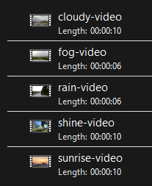
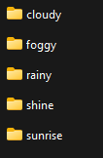


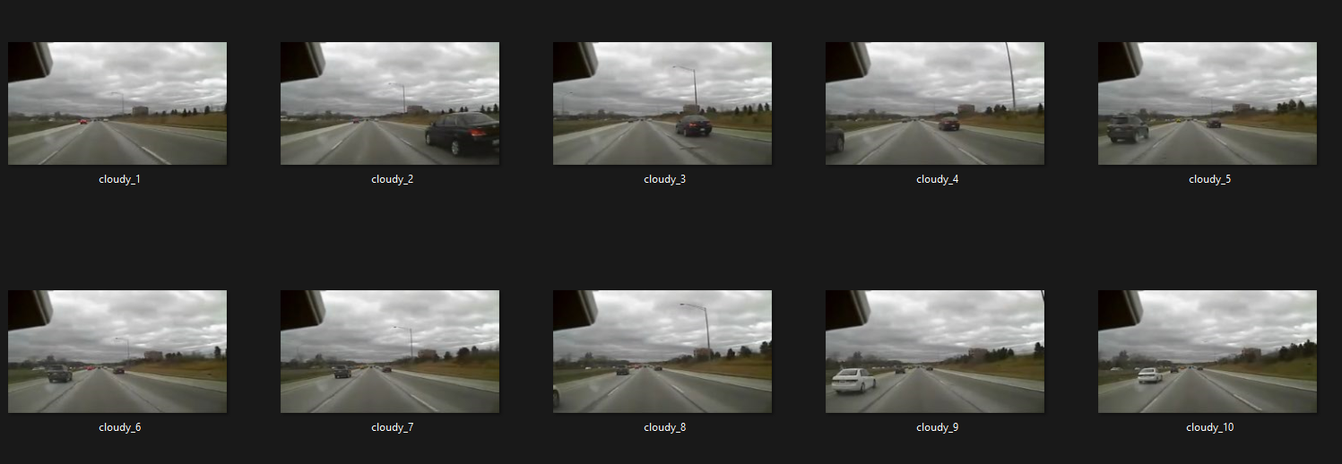
Every 24 frames saved as 1 image
about 10 seconds video from youtube/self-recorded
(also support for longer videos)

Slide 11
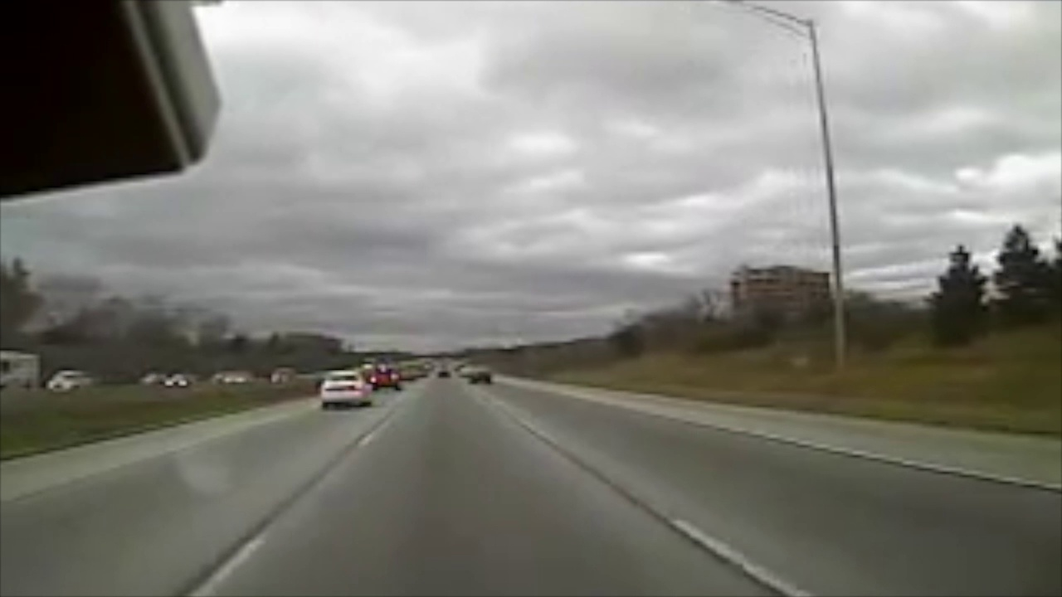
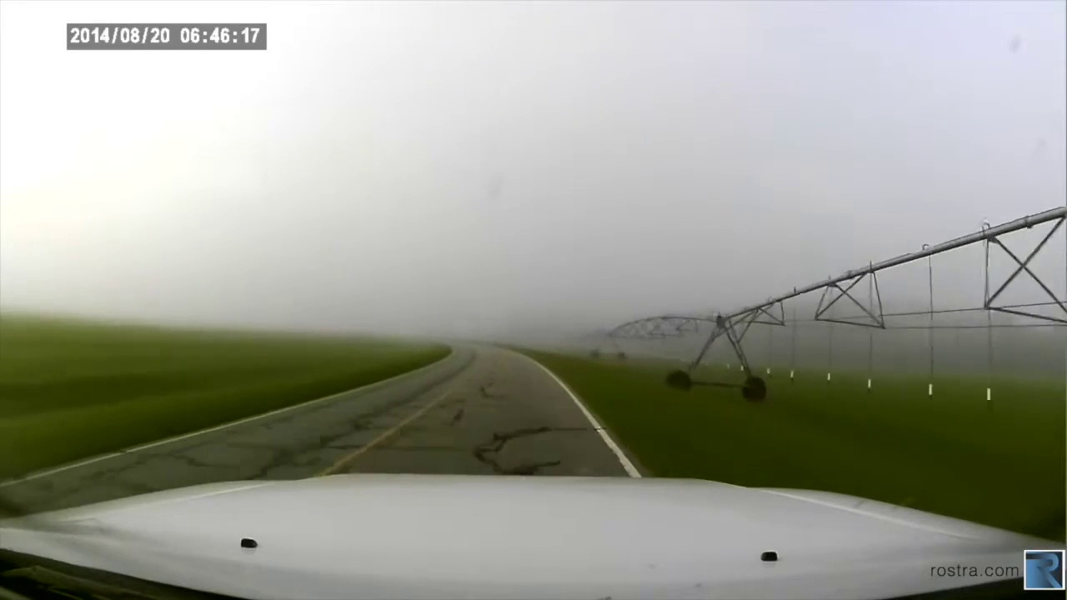
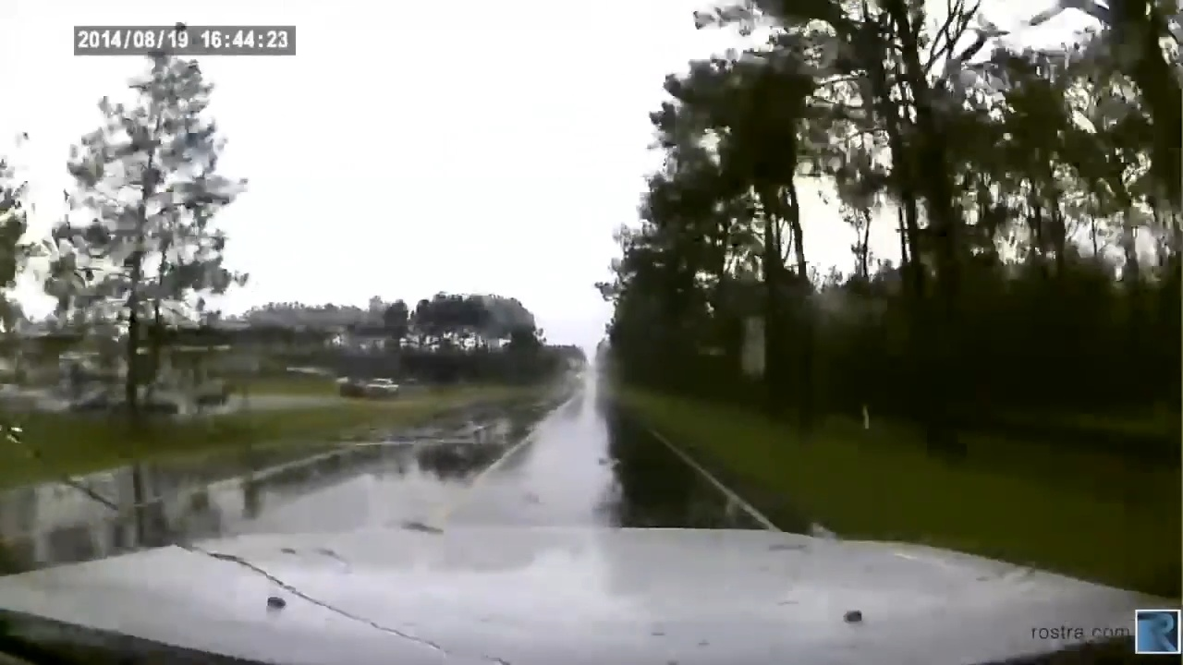
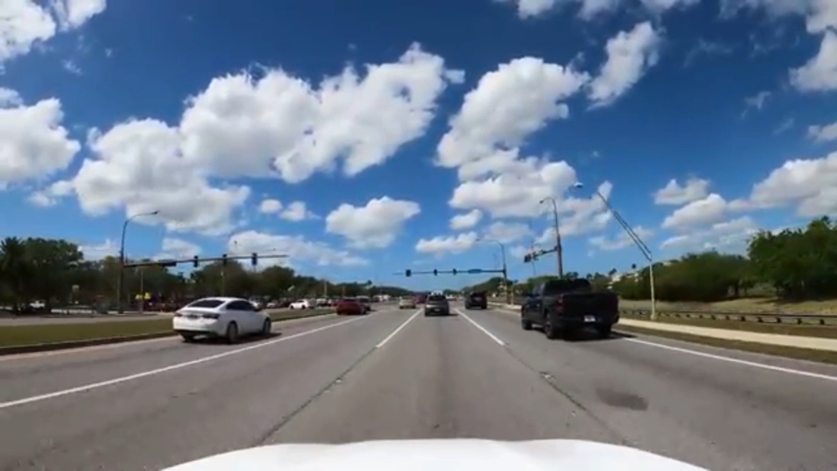
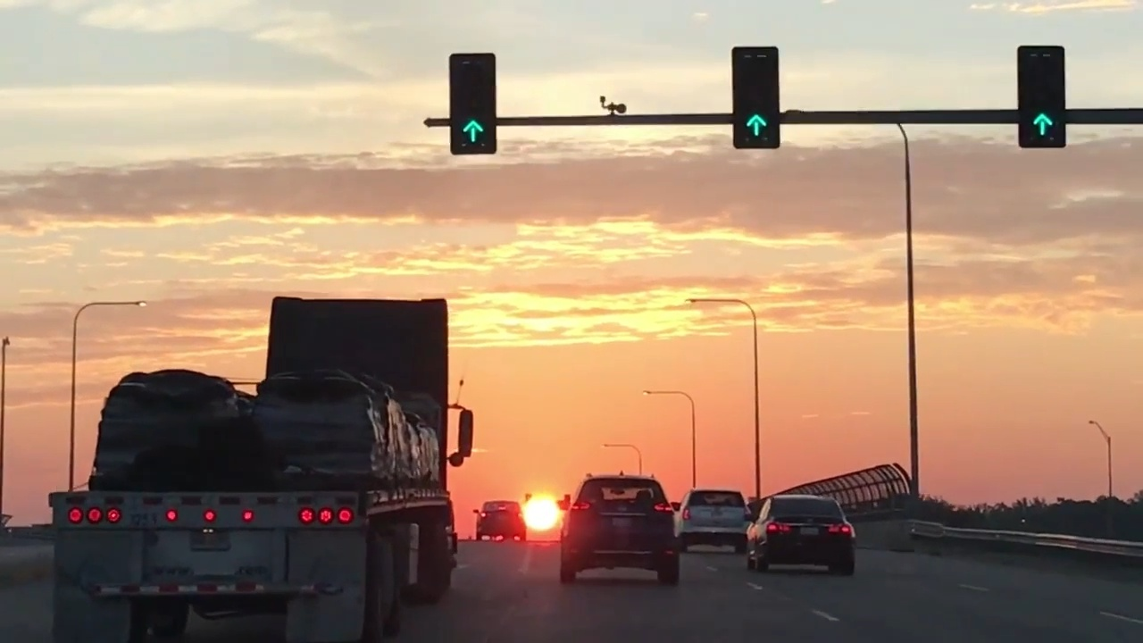
Frames of Youtube Video:
Wrong Prediction !
True: Cloudy
VGG16: Class0 (Cloudy)
Resnet: Class 0 (Cloudy)
True: Foggy
VGG16: Class 0 (Cloudy)
Resnet: Class 1 (Foggy)
True: Rainy
VGG16: Class 0 (Cloudy)
Resnet: Class 0 (Cloudy)
VGG16 gets wrong
True: Sunshine
VGG16: Class 0 (Cloudy)
Resnet: Class 3 (Sunshine)
True: Sunrise
VGG16: Class 4 (Sunrise)
Resnet: Class 4 (Sunrise)

Slide 12
Testing on VGG16 and Resnet on Real world Driving Video Frames
Accuracy Score Overall:
VGG16 : 50 %
Resnet : 85.7 %

Slide 13
Why Mis-Classification
Discussion on Weather Classification

Slide 14
Input : Videoes with weather
Output : Prediction on Weather (eg. rain or fog or shine)

Slide 15
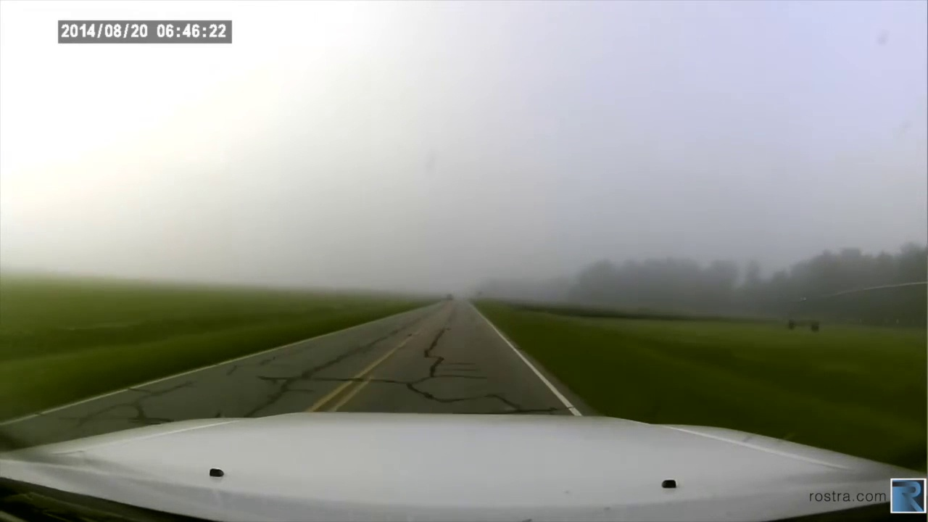
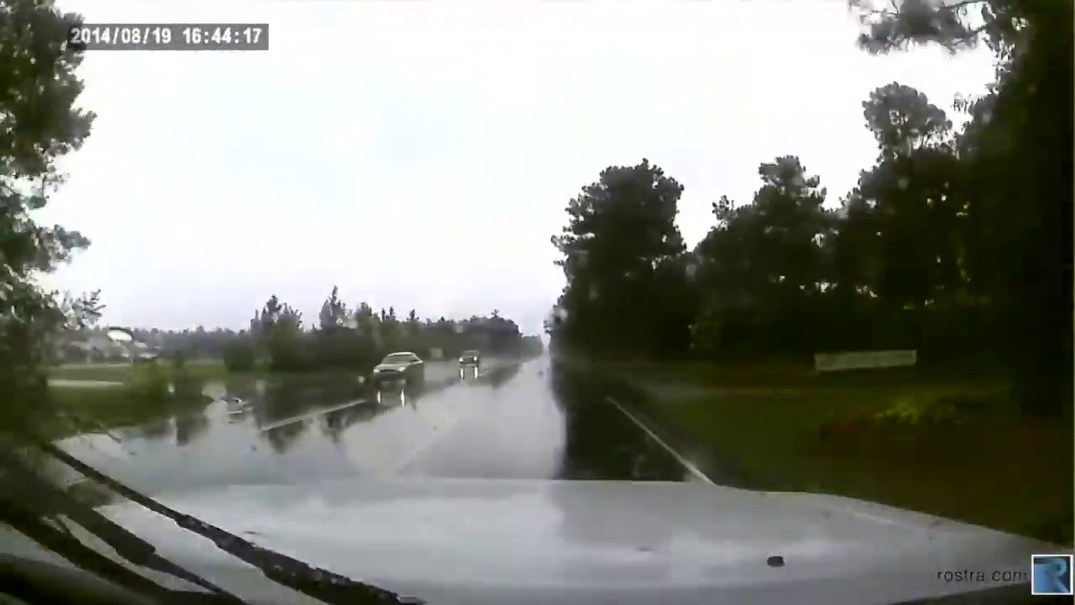
First 30 Seconds —-----> Second 30Seconds
Difficult to identify change of weather with similar scene

Slide 16
What’s Next?
De-rain and De-fog
Weather Image Style Transfer

Slide 17
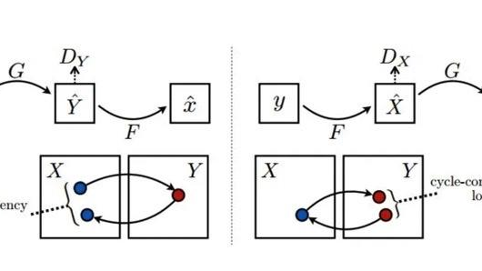
CycleGan

Slide 18
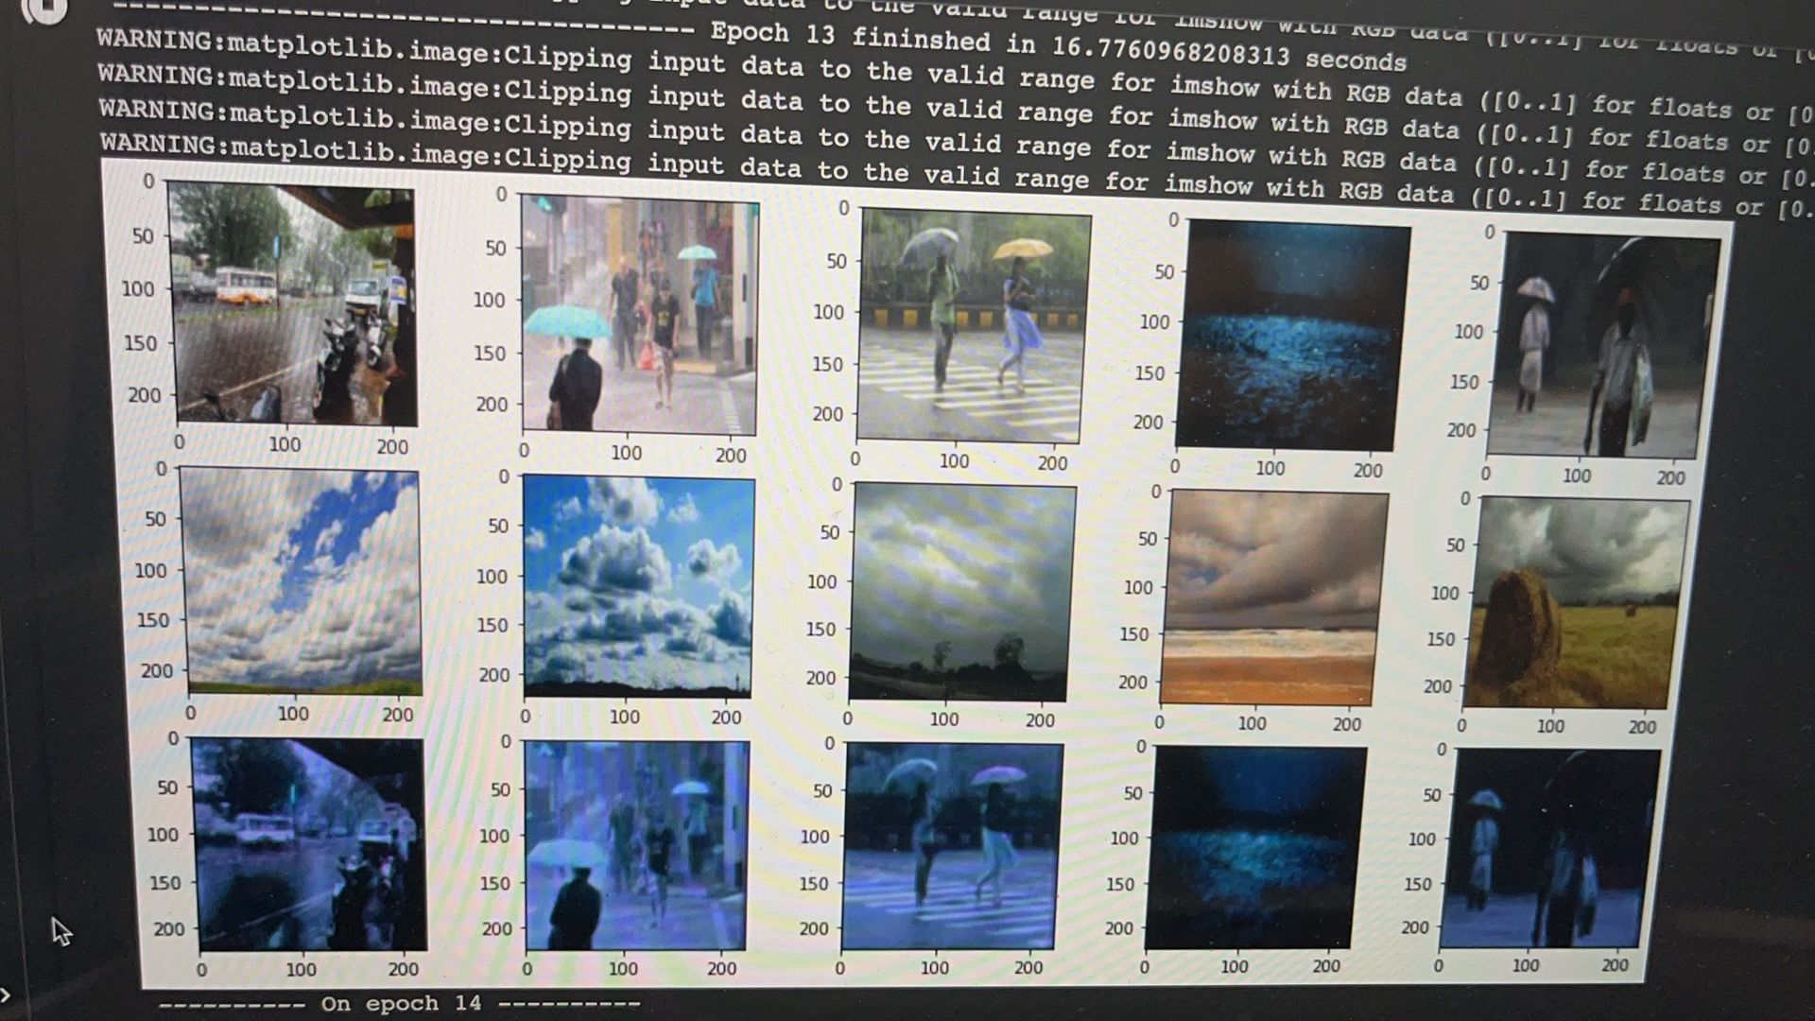
13 Epoches

Slide 19
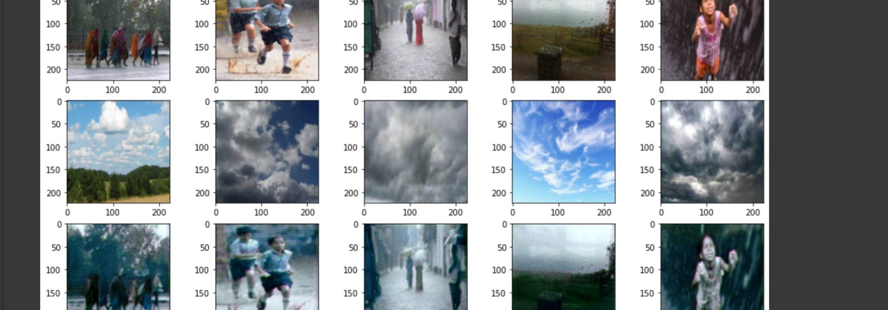
21 Epoches

Slide 20
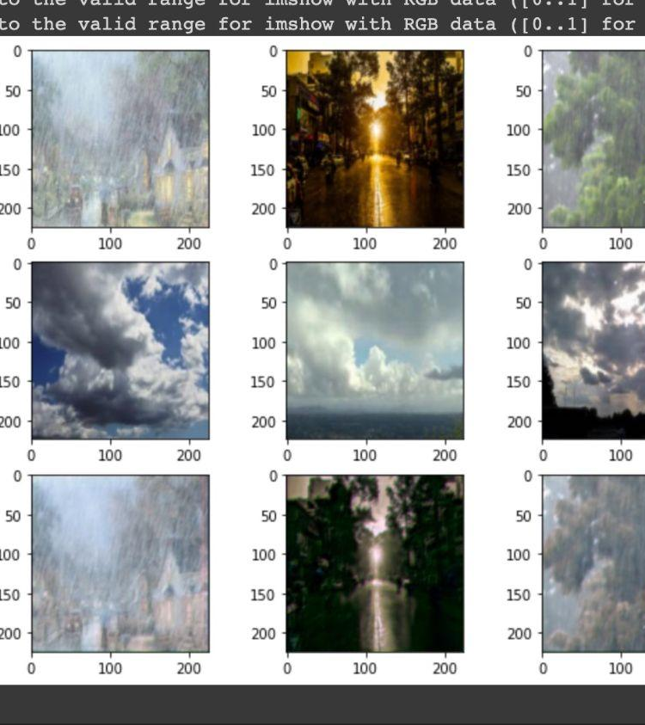
35 Epoches

Slide 21
Goal : De-Rain/De-Fog
Actual : Image Filters, style Transfer

Slide 22
Data Preparation

Slide 23
Thank you For All

